Slide 1
ELECTRICAL PROGRESS REPORT WEEK 7
TEAM
-Eunice Orenge
-Laban Mwangi
-Stephen Kinuthia
-Victor Maina

Slide 2
OBJECTIVES OF THE WEEK
a) Identify a suitable motor controller for replacement.
b) Finalize on the design of the DC-DC step down module.

Slide 3
a) MOTOR CONTROLLER REPLACEMENT
It was decided that the controller would be replaced with a similar type from the same company; SLIDER.
Plans are already in place to purchase the controller and have it delivered.

Slide 4
INVOICE
ITEM | PRICE PER PIECE | AMOUNT
Motor Controller | $610 | $610
Display (with harness, CAN, USB cable) | $85 | $85
Pedal | $25 * 2 pcs | $50
DC-DC convertor (100v-12v) | $120 | $120
Shipping | - | $245
TOTAL | - | $1140

Slide 5
b)DC-DC STEP DOWN MODULE DESIGN
The design of the 12v-5v DC-DC step down model was improved with help from the Navigation team and Nakuja members.
We used KiCad for the PCB editing.

Slide 6
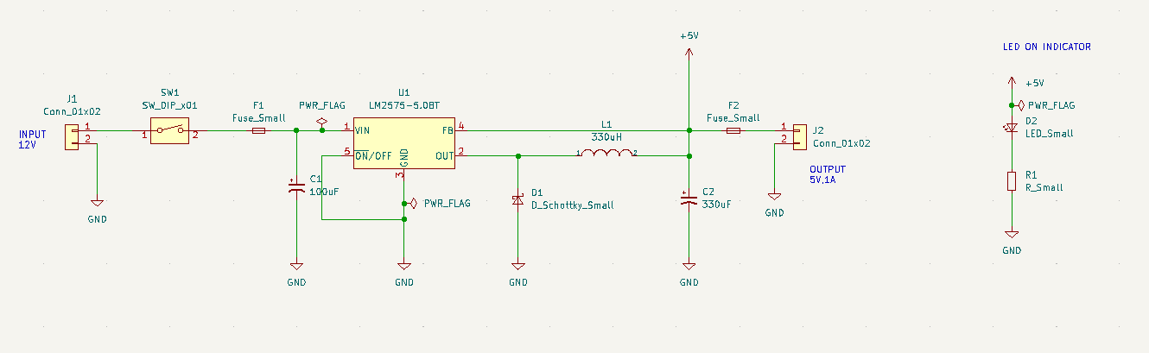
i) Schematic Diagram

Slide 7
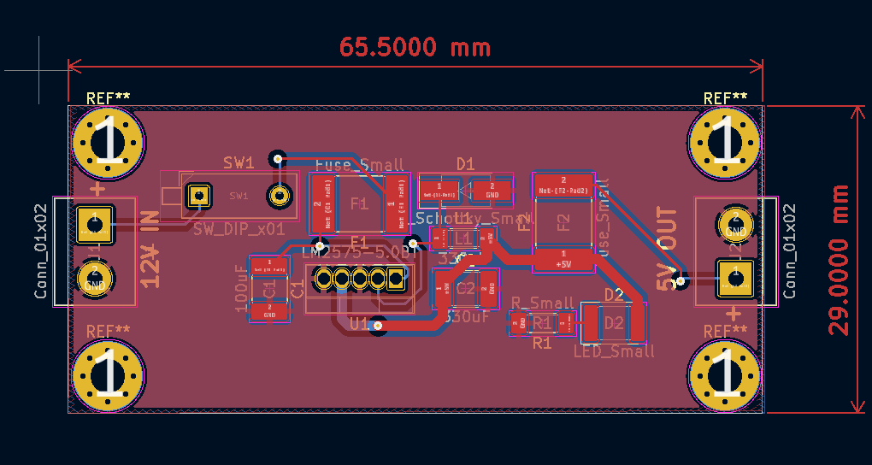
ii) PCB editor in KiCAD

Slide 8
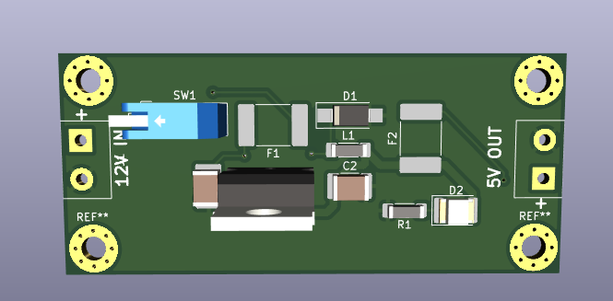
iii) 3D Model

Slide 9
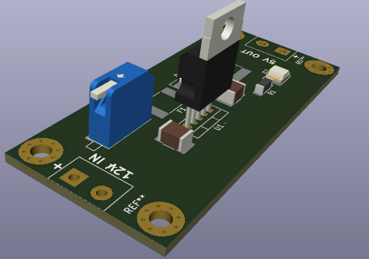
iii) 3D Model

Slide 10
TASKS TO BE DONE
Acquire components and begin the fabrication process of the DC-DC step down module.

